Slide 1
Thesis
Hotel Booking & Reservation System
Using MEAN stack technology and Spring MVC framework
Presented by Đỗ Hùng Cường

Slide 2
Table of contents
1. Introduction
2. Use case & features
3. Technology used
4. System Architecture
5. Database Structure
6. Demo

Slide 3
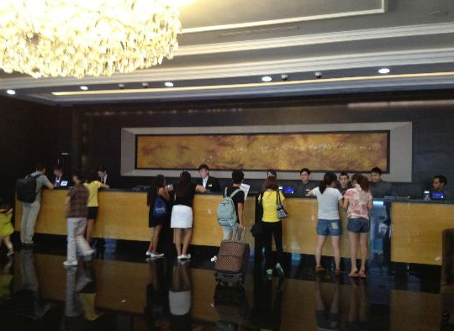
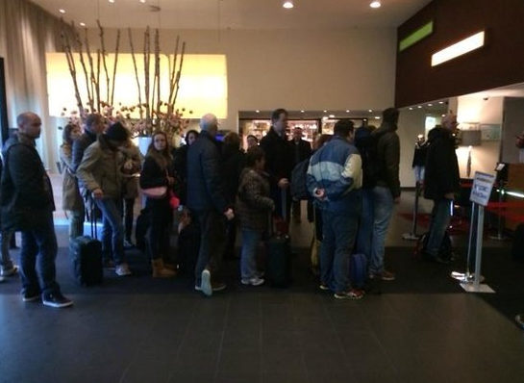
Introduction
Many BIG hotel + big amount of customer => difficult management
Customer have to come to hotel for booking => waste time, not convenient
=> Need software + website for hotel booking.

Slide 4
Introduction
Weakness:
+ always load page, run very slow => customers don’t feel comfortable
+ administrators may not know customer’s behavior on software or website
Five Star hotel System:
+ Very powerful & can track and collect customer’s behavior
My purpose :
+ Build a powerful system for hotel booking & reservation like Five star hotel system
My Hotel Booking & Reservation System
+ Single page application => high performance => more comfortable
+ Fully features support for Hotel Booking & Reservation
+ Track customer’s behavior => follow customers => improve hotel business.

Slide 5
Use Case

Slide 6
List of features
No. | Feature | User | Begin | Finish | Duration
<no> | <name of topic to present> | <user who use feature> | <mm/dd/yyyy> | <mm/dd/yyyy> | <number of day>
1 | Register | Guest, Admin | 09/06/2017 | 11/06/2017 | 2
2 | Login | Guest, Admin | 11/06/2017 | 13/06/2017 | 2
3 | Logout | Customer, Admin | 13/06/2017 | 15/06/2017 | 2
4 | View Rooms | Guest, Customer, Admin | 15/06/2017 | 17/06/2017 | 2
5 | View Restaurant | Guest, Customer, Admin | 17/06/2017 | 19/06/2017 | 2
6 | Search for Room | Guest, Customer, Admin | 19/06/2017 | 23/06/2017 | 4
7 | Search for Food, Drink | Guest, Customer, Admin | 23/06/2017 | 25/06/2017 | 2
8 | View gallery of hotel | Guest, Customer | 25/06/2017 | 26/06/2017 | 1
9 | View introduction of hotel | Guest, Customer | 26/06/2017 | 27/06/2017 | 1
10 | Filer rooms | Guest, Customer, Admin | 27/06/2017 | 29/06/2017 | 2
11 | Filer food or drink | Guest, Customer, Admin | 29/06/2017 | 01/07/2017 | 2
12 | Send contact | Guest, Customer | 01/07/2017 | 04/07/2017 | 3
13 | Send reservation form | Guest, Customer | 04/07/2017 | 08/07/2017 | 4
14 | Book room | Customer | 08/07/2017 | 12/07/2017 | 4
15 | Cancel room | Customer | 12/07/2017 | 15/07/2017 | 3
16 | View profile | Customer, Admin | 15/07/2017 | 18/07/2017 | 3

Slide 7
List of features (cont.)
No. | Feature | User | Begin | Finish | Duration
17 | Edit profile | Customer, Admin | 18/07/2017 | 22/07/2017 | 4
18 | Change password | Customer, Admin | 22/07/2017 | 26/07/2017 | 4
19 | View activity | Customer | 26/07/2017 | 28/07/2017 | 2
20 | Send feedback | Customer | 28/07/2017 | 02/08/2017 | 5
21 | Dashboard management | Admin | 02/08/2017 | 09/08/2017 | 7
22 | Receive notification | Admin | 09/08/2017 | 15/08/2017 | 6
23 | Send message | Admin | 15/08/2017 | 18/08/2017 | 3
24 | View users | Admin | 18/08/2017 | 22/082017 | 4
25 | Manage users | Admin | 22/082017 | 25/08/2017 | 3
26 | Ban users | Admin | 25/08/2017 | 29/08/2017 | 4
27 | Add new room | Admin | 29/08/2017 | 02/09/2017 | 4
28 | Delete room | Admin | 01/09/2017 | 05/09/2017 | 4
29 | Update room | Admin | 04/09/2017 | 07/09/2017 | 3
30 | Add food or drink | Admin | 06/09/2017 | 08/09/2017 | 2
31 | Remove food or drink | Admin | 08/09/2017 | 11/09/2017 | 3
32 | Update food or drink | Admin | 11/09/2017 | 15/09/2017 | 4
33 | Update profile image | Admin | 15/09/2017 | 16/09/2017 | 1
34 | Follow users | Admin | 16/09/2017 | 23/09/2017 | 7
35 | Send feedback & rate hotel | Customer | 23/09/2017 | 30/09/2017 | 7
36 | Send feedback & rate room | Customer | 30/09/2017 | 07/10/2017 | 7
37 | View customer activity | Admin | 07/10/2017 | 14/10/2017 | 7
38 | View statistic of visit times | Admin | 14/10/2017 | 21/10/2017 | 7
39 | View recommendation room | Guest, Customer | 21/10/2017 | 28/10/2017 | 7
40 | View related room | Admin | 28/10/2017 | 04/11/2017 | 7
41 | View top of rooms | Guest, Customer, Admin | 04/11/2017 | 11/11/2017 | 7
42 | Email template | Admin | 09/11/2017 | 18/11/2017 | 7

Slide 8
Technology used
1. Back end: - Java web J2EE + Spring MVC framework
- Node.js + Express framework
2. Front end: - HTML5, CSS3, Javascript, Jquery, Boostrap
- Angular 2 framework
3. Database: MongoDB
4. Server: Glassfish, npm http server
5: Version control: Git
6: Project management tool: Trello
7: Other tool: Edraw, Netbeans, Vscode, RoboMongo

Slide 9
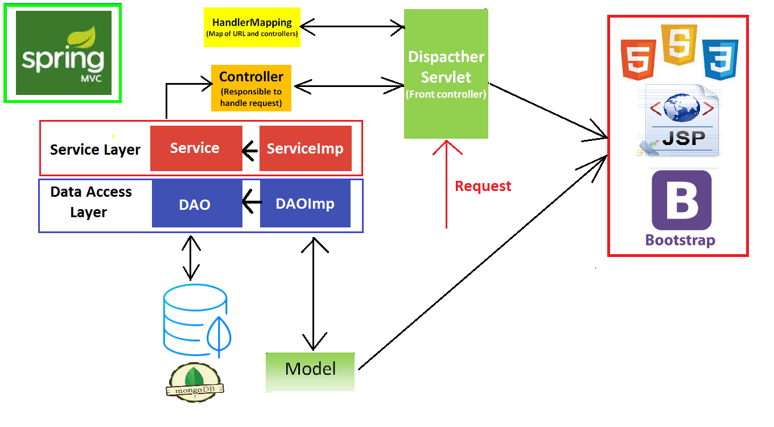
System Architecture

Slide 10
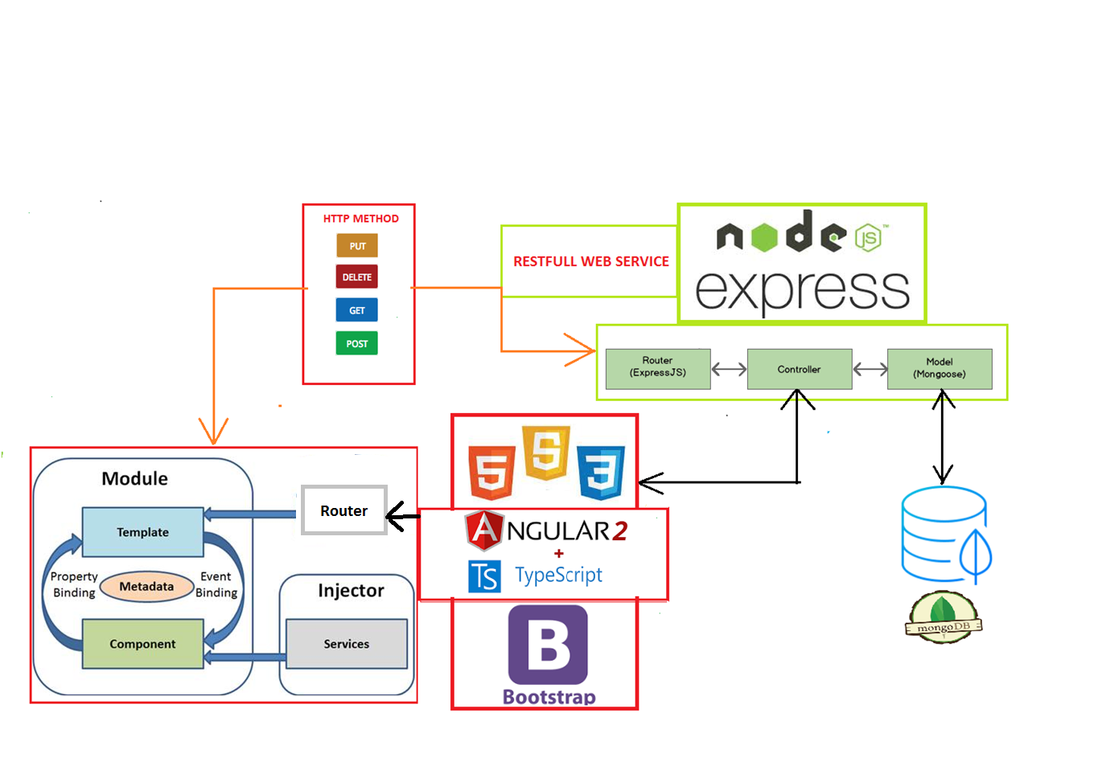

Slide 11
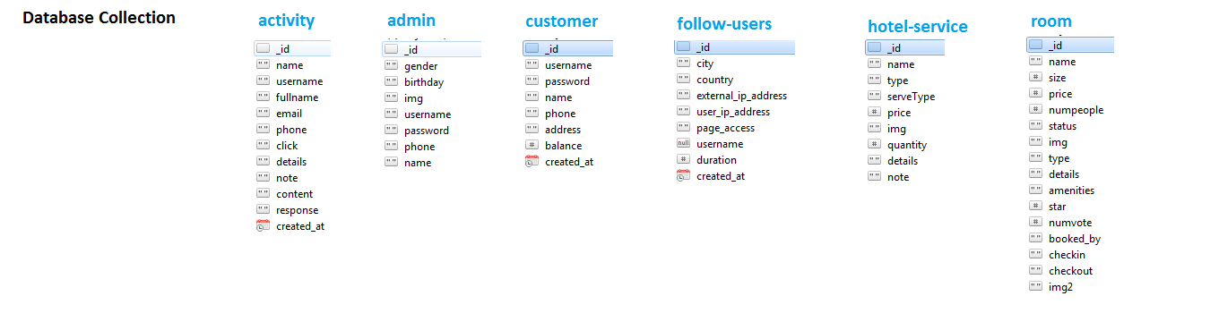
Database Structure

Slide 12
Demo

Slide 13

Thank you for your listening

